Slide 1


Python mini project
Tic-Tac-Toe (Multiplayer and AI)
BY-Sayyam Jain (16010520093)
Dhanesh Thakker (16010520100)
Utkarsh Verma (16010520104)
Saurabh Rane (16010520089)

Slide 2
PROBLEM STATEMENT
Create a program in python to execute a game of tic-tac-toe, Make two codes one for Multiplayer and one for AI

Slide 3


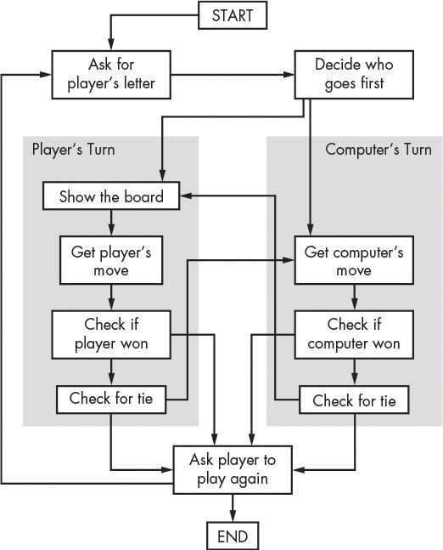
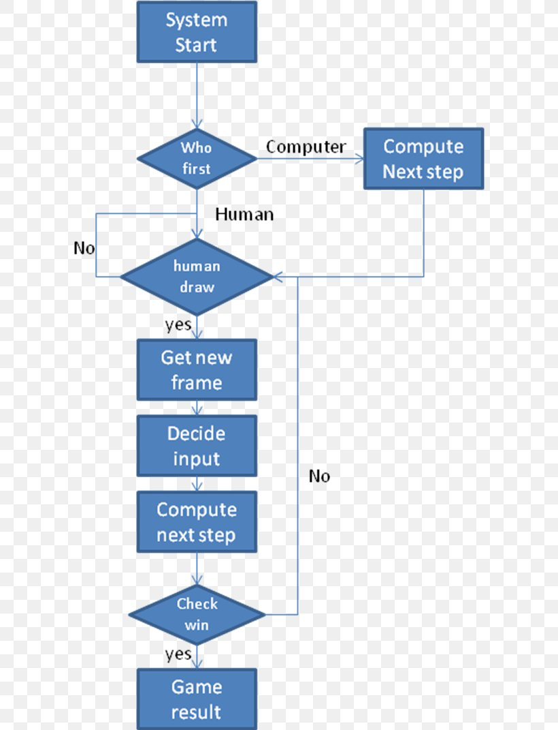


System architecture
Tic-Tac-To is a game in which two players seek in alternate turns to complete a row, a column, or a diagonal with either three O's or three X's drawn in the spaces of a grid of nine squares; noughts and crosses.

Slide 4


Features of designed system
1.Multiplayer
This program is a designed in such a way that the game can be played by two individuals by just typing the number of the box each player wants to fill with cross(X) or naughts(O). For the game to finish the program should be able to see if either of the rows or columns are filled with crosses(X) or naughts(O),This is done by: check win() in which all the winning combinations are stored .if the board has no empty spaces left the programs deems it as draw with: check draw() as no row or column has been completely filled with either of the symbols.
Another feature of this program is the ‘SCOREBOARD’ it is stored as a dictionary where keys are the player names and values are their win number,the keys which are the player names are extracted using .keys() function and converted into list.
After each match the scoreboard needs to be updated which is done by:
player_won = player_choice[winner]
Score_board[player_won] = score_board[player_won] + 1
If the game is not ended in a draw,then we update the scoreboard

Slide 5
Features of designed system
2. A.I.
This program may run the same game and have the same board as the multiplayer version but instead of two individuals playing the game it is played by the A.I by using: comp move() which contains the set if possible moves the computer can do, and using selectRandom() which selects a random move from the set of moves , also it is programmed in such a way that the AI always selects optimal moves in order to increase the difficulty of this game

Slide 6
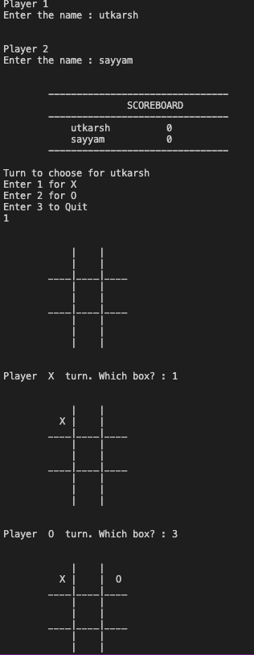
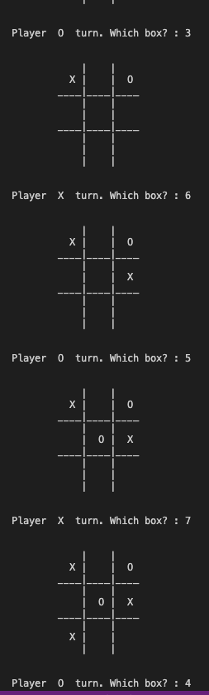
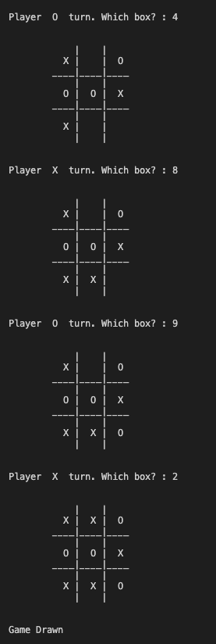
Result
1.Multiplayer

Slide 7
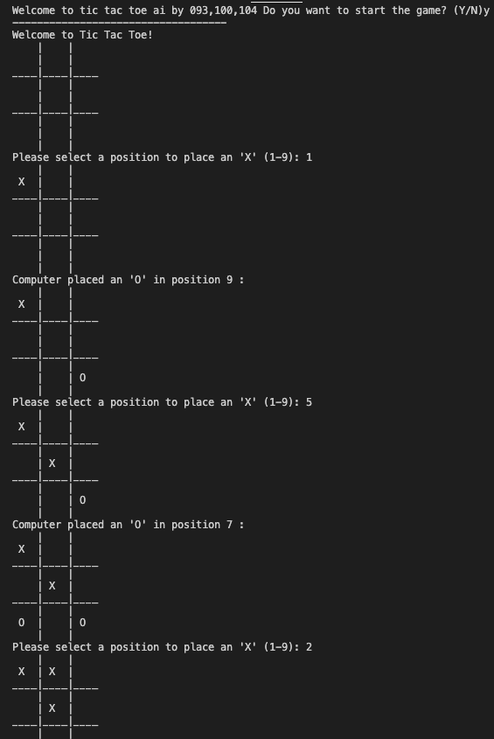
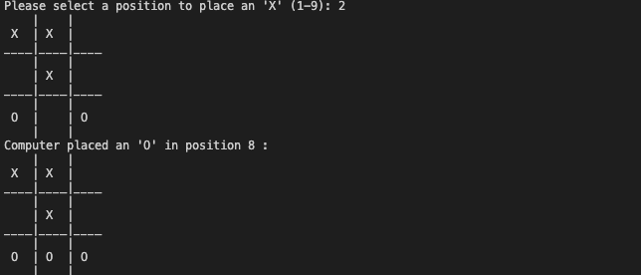
Result
2. A.I.
Game 1

Slide 8
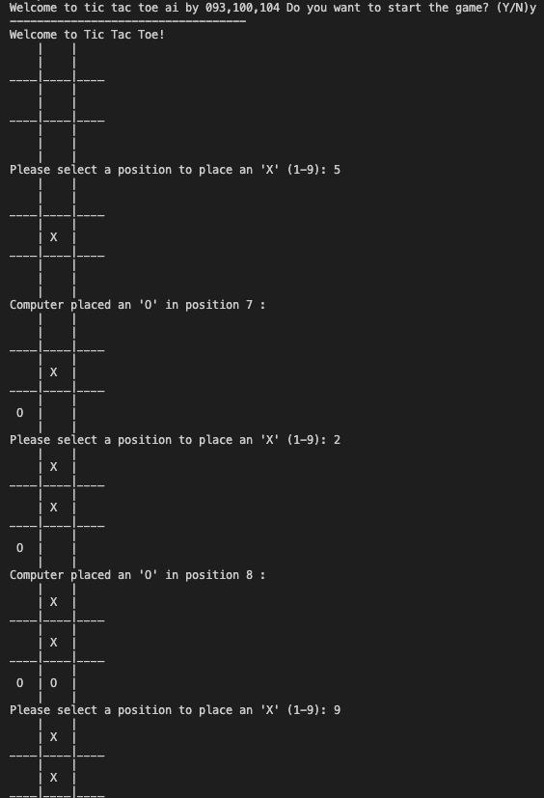
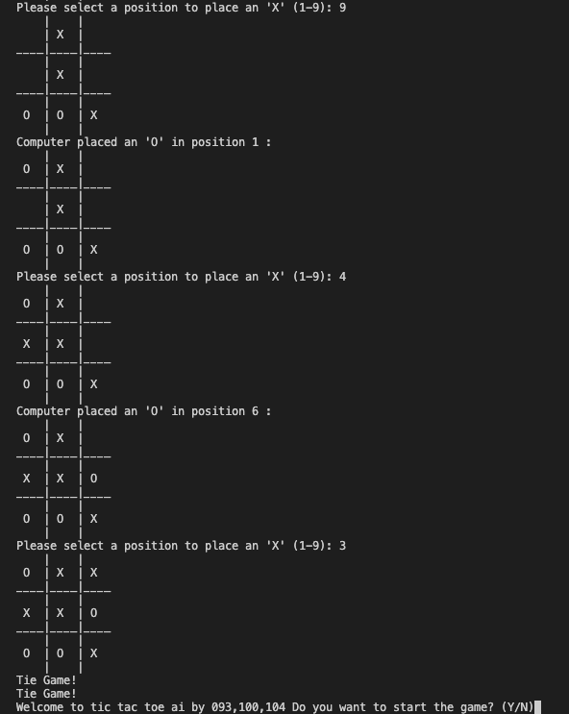
Result
2. A.I.
Game 2

Slide 9
Conclusion
By making this program that runs the game of tic-tac-toe (multiplayer and A.I). we got to know some more functions and also got to learn some of the new applications of the functions we have already learnt.We also got some experience in making code for running games and understood how the game worked in more depth we also got to learn how to make AI to play against us and had fun while playing the finished result in both playing the game with each other nad also playing against AI

Slide 10
References
https://www.techwithtim.net/tutorials/python-programming/tic-tac-toe-tutorial/
https://www.askpython.com/python/examples/tic-tac-toe-using-python
https://www.youtube.com/watch?v=5s_lGC2sxwQ
https://www.youtube.com/watch?v=jAaJZLqryTI&t=3s
https://www.youtube.com/watch?v=JC1QsLOXp-I&t=12s
https://www.youtube.com/watch?v=2Tr8LkyU78c

